Slide 1
Geotextile & PVC MEMBRANE for TUNNEL Waterproofing
MANAS GEO TECH INDIA PVT LTD

Slide 2
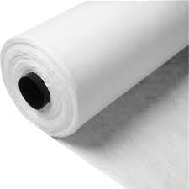
Non-Woven Geotextile made by high tenacity polypropylene staple fibres, needle-punched and/or thermos calendared, without resins or glues, UV stabilized. It is not toxic and does not pollute the environment. It is resistant to alkalis, acids and organic substances. Moulds, rodents and microorganisms cannot attack GEO. Its qualities and properties are not substantially modified by climatic factors like frost, heat, humidity etc.

Slide 3
applications
CUT & COVER TUNNEL
NATM TUNNEL
Geotextile non woven made by PP high tenacity, UV stabilized, contributes to improve the useful life of tunnels.

Slide 4
USE: as protection layer of a geomembrane, and as drainage layer of seepage water in the underground structures INSTALLATION: interlayer between the waterproofing geomembrane and a surface of shot concrete REFERENCE STANDARD: EN 13256 (Geotextiles and geotextile-related products. Characteristics required for use in the construction of tunnels and underground structures) RELEVANT CHARACTERISTICS: protection efficiency, water flow capacity in the plane, durability. RECOMMENDED PRODUCTS: to be chosen according to the level of protection efficiency required, for example mgt-50 to mgt-70, 500 to 700 g/m2
USEFUL INFO

Slide 5
UNIT WEIGHT AND ROLL SIZE RANGE > UNIT WEIGHT: 500 - 700 g/m2 > ROLL SIZE: max roll width 5 Meter
QUALITY CONTROL
In our internal laboratory the mechanical and hydraulic characteristics of the final product are tested, as well as the quality of the fibre.
CERTIFICATIONS:
ISO 9001:2015
ISO 45001:2018
ISO 14001:2015
CE (Certificate of Compliance)

Slide 6
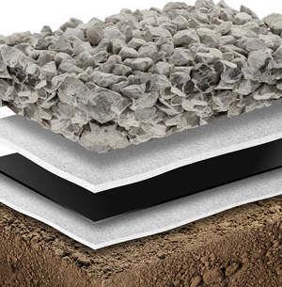
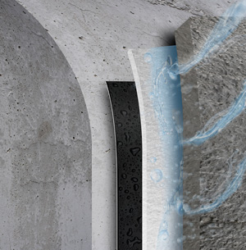
PROTECTION
FUNCTIONS:
The surface of some works or elements which should guarantee a perfect waterproof, must be successfully protected from mechanical damage caused by the contact with natural or artificial elements. Manas Geotextiles and PVC Geomembrane are used to protect waterproofing systems in tunnels, waste reservoirs, basins, canals, and can be installed in building constructions.
DRAINAGE
The drainage capacity of geotextiles means the chance to carry along its plane the water collected from the ground or from other materials in contact. A typical example is the drainage in underground works and drainage systems in tunnels or in waste disposals.

Slide 7
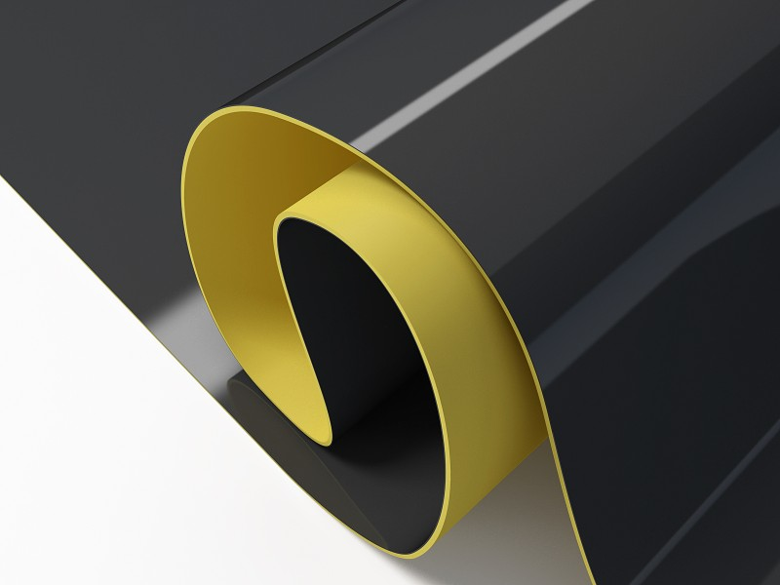
PVC geo Membrane for Waterproofing
PVC waterproofing membrane (PVC = Polyvinyl Chloride) is a single-ply sheet requiring only one layer of the membrane. PVC membranes have a wide range of benefits for tunnels, the most important being saving thousands in remediation, repairs, maintenance, or replacement over the expected lifespan of the project.
We have setup a new PVC Membrane plant after working in tunnel industry closely 6 years. We are using a constant formula & those that are supplied from Europe are governed by strict guidelines as to the chemical composition, formulation etc.
Our PVC sheet membranes are manufactured using superior raw materials chosen for strength and durability, giving PVC waterproofing membranes a very long service life.

Slide 8
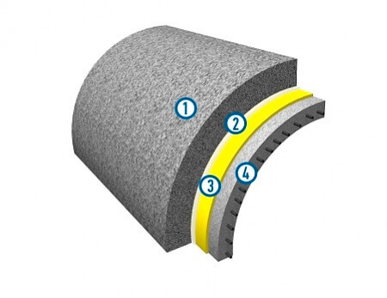
Underground method of tunnel construction
Providing PVC sheet membrane products are installed correctly, they will provide long term waterproofing protection. PVC membranes don’t need any curing time to become waterproof and their thickness will always be consistent throughout the entire application. PVC sheet membranes protect structures immediately after their installation and finishes can be applied over them immediately.
The Manas Membrane has an elongation of over 300% allowing a structure to move without tearing/splitting the membrane and thus maintaining the waterproofing integrity.
1 | Concrete foundation, reinforced concrete
2 | Drainage layer, geotextile, 500-1000 g/m2
3 | PVC GEO membrane containing a waterstops and injectors system
4 | Main structure, reinforced concrete

Slide 9
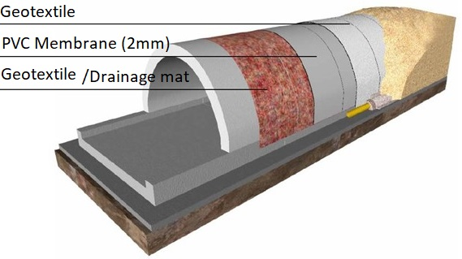
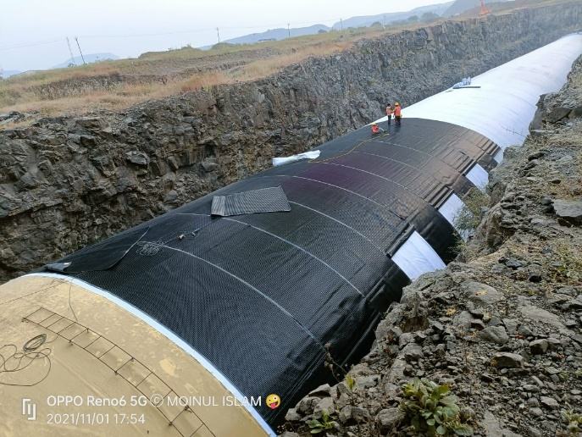
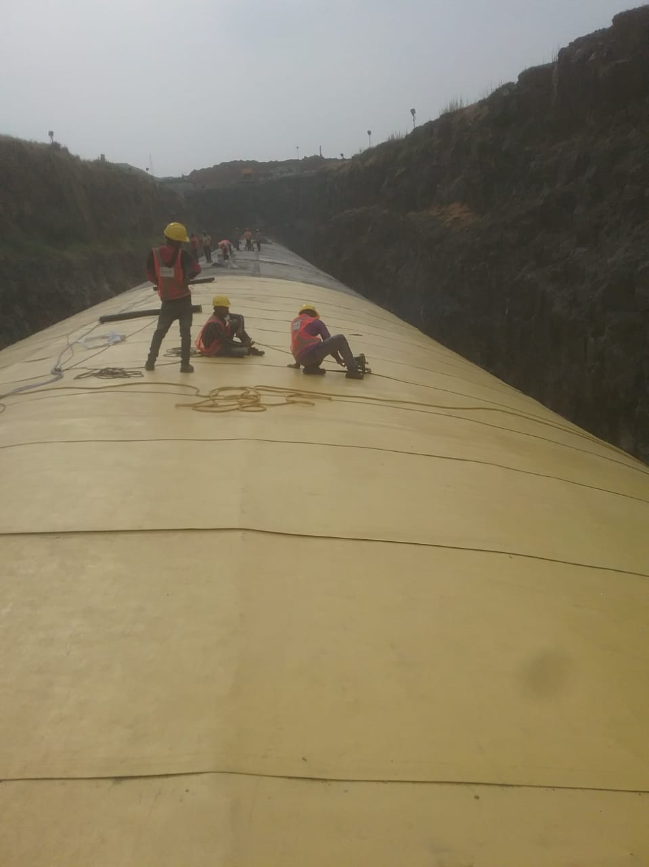
Application: Cut & COVER Tunnel
ROAD TUNNELS Waterproofing of cut-and-cover structures and mined tunnels for roads and express ways.

Slide 10
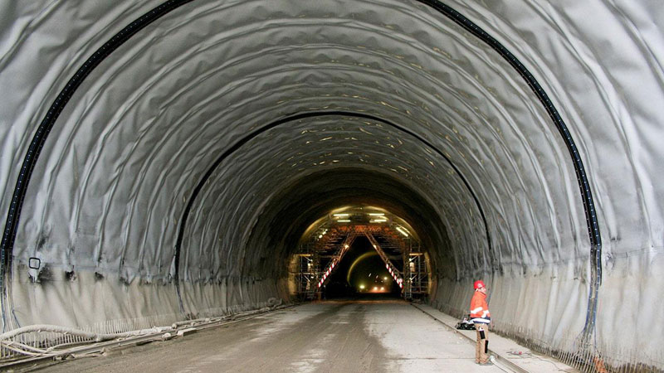
NATM (New Austrian Tunnelling Method ) Tunnel
The double-layered system of PVC-P, in combination with waterstop, injection valves, hoses, a tunnel waterproofing system can be divided and compartmentalised into small independent watertight sections. The tunnel/ structure is therefore divided into manageable sections that can be treated as individual entities. This system allows us to test for water-tightness at locations suspected of accidental damage, or in the case of leakage. Furthermore, the water infiltrations would be limited to the single damaged section/compartment. Any damage/leakage would remain localised, thus rendering easy rectification, and thereby mitigating one of the major concerns with traditional PVC-P applications. This compartmentalization forms this watertight control by utilising the gap between the two waterproofing membrane layers.
This gap can be exploited to monitor the waterproofing system sealing and allows for simple future repairs by resin injection. PVC-P twin layer membrane is generally used as a waterproofing membrane, must be highly durable and shall be judiciously selected. The product should be made up of virgin PVC compound and plasticized for long term flexibility and durability. The membrane shall be supplied with a signal layer, i.e. a thin sheet of different colour, bonded to one side, which is intended to facilitate the detection of damage.

Slide 11
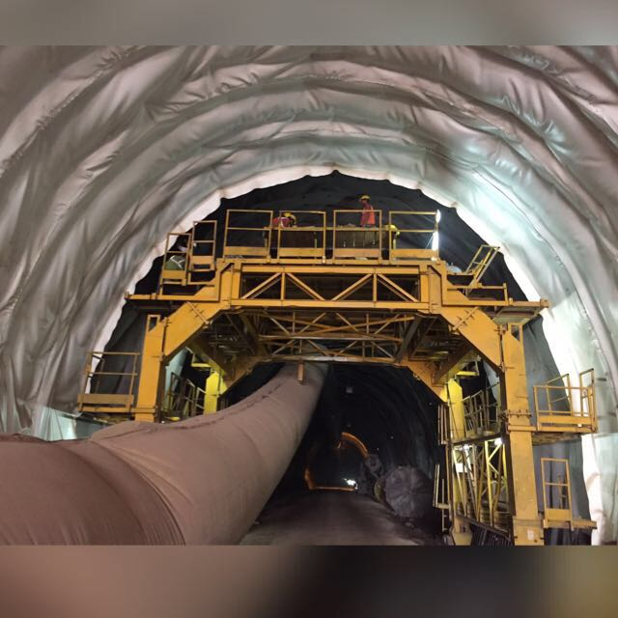
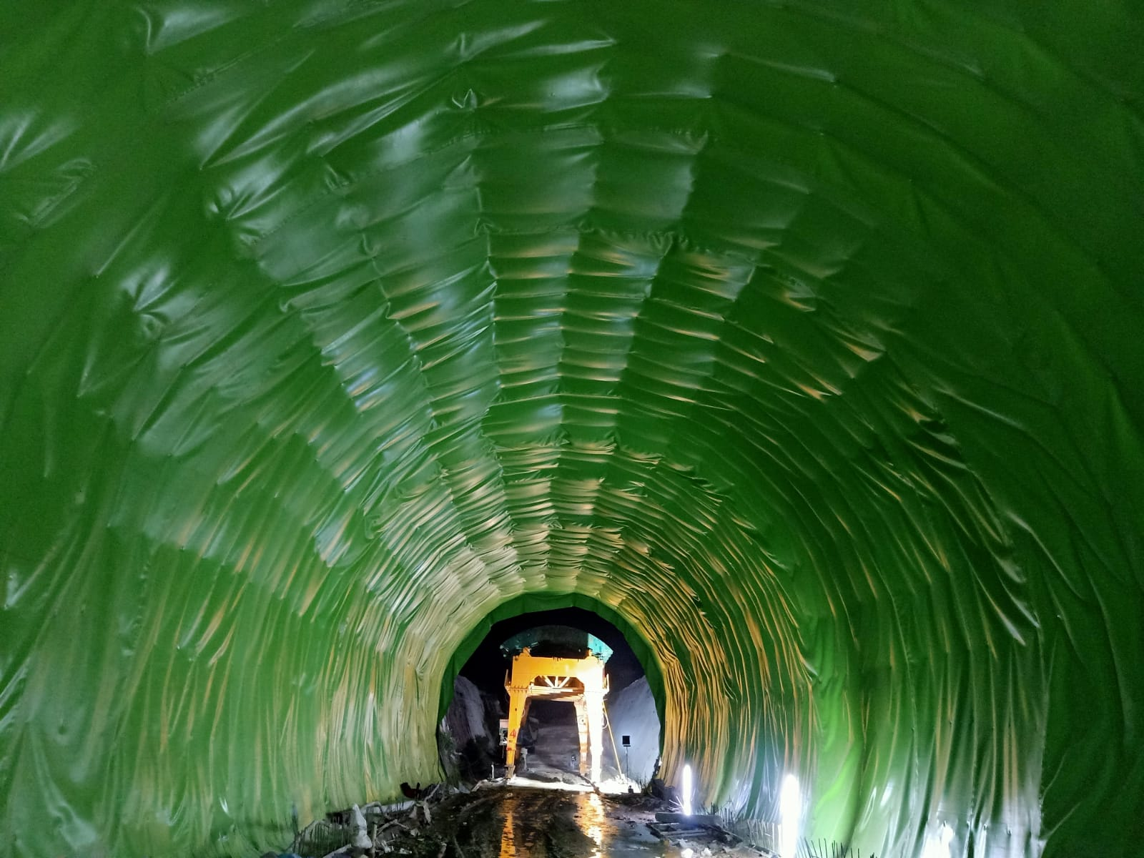
Few pictures for references:
PVC waterproofing membrane system

Slide 12
THANK YOU
Corporate office:
FF-25,Vasant Square Mall, Plot No – A
Community Center, Pocket 5, Sector B , Vasant Kunj New Delhi - 110070
Ph : 011-4600 0770
www.manasgeotextile.com
Factory Address:
Plot No – 189, Phase-I, IMT Bawal, 123501- (Haryana) India
Ph : 9643003963

