Slide 1

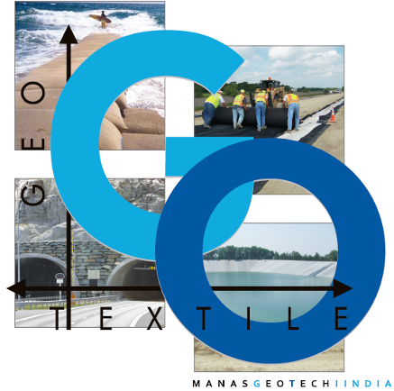
MANAS GEO TECH INDIA PVT. LTD.
An ISO 9001: 2008 Certified Co.
AN INDO-ITALIAN COLABORATION

Slide 2

Geo Textile
Geo Textiles are Permeable Fabrics , Which when used in association have the ability to Separate , Filter , Reinforce , Protect or Drain . Typically made from Polypropylene & Polyester ,
Geo Textile comes in 3 Forms
Non Woven Geo Textile
Woven Geo Textile
Heat Bonded Geo Textile
Head Off:
Manas Geo Tech India Pvt Ltd
FF-25 Vasant Square Mall Plot Number A Community Center Pocket 5 Sector B Vasant Kunj New Delhi 110070
INDIA
Works :
Plot Number 189, Sector 3 Phase 1
IMT Bawal Haryana 123501
INDIA

Slide 3
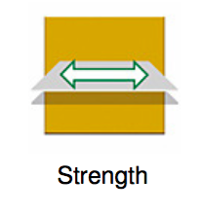
Functions of Non Woven Geo Textile
Needle punched Non Woven Geo Textile are sheets with are bonded together by Entangling Fibers mechanically with the help of needle punching.
Functions
Re-Enforcement – Geo Textile Improves
the Overall Strength of the soil . They Prevent
Lateral Spreading of the base , Increases the confinement and
Improves the vertical stress distribution of the sub-grade.

Slide 4
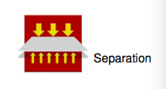
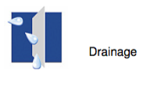
Separation – Non Woven Geo Textile
Helps in keeping the two layers of the soil
Namely subgrade & Aggregate apart, Thus
Preventing mixing and in turn deterioration of their function in the structure
Drainage – Non Woven Geo Textile
Have a very high Permeability and allows
Water to flow freely along the plane into the
Side ditches . This function allows adequate liquid flow without
Soil loss. Example – Most Common Examples Tunnel Waterpoofing, Canal Lining

Slide 5
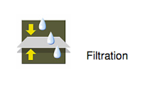
Filtration – Non Woven Geo Textile Allows adequate liquid flow across The plane of the Geo Textile . The Apparent Opening Size ( AOS) Allows water to pass Freely from the Geo Textile while preventing Soil to pass through the same . This is due to the Skillful Manufacturing of Non Woven Geo Textile AOS , That the AOS is always keep lower than the size of the Finer Soil Particle

Slide 6
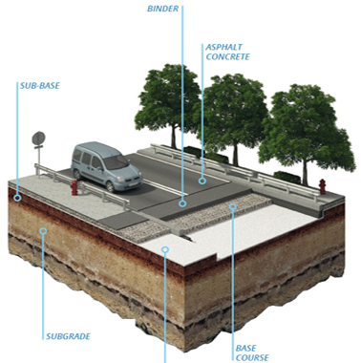
APPLICATION OF NON WOVEN GEO TEXTILE
Roads & Highways
Geo Textile

Slide 7
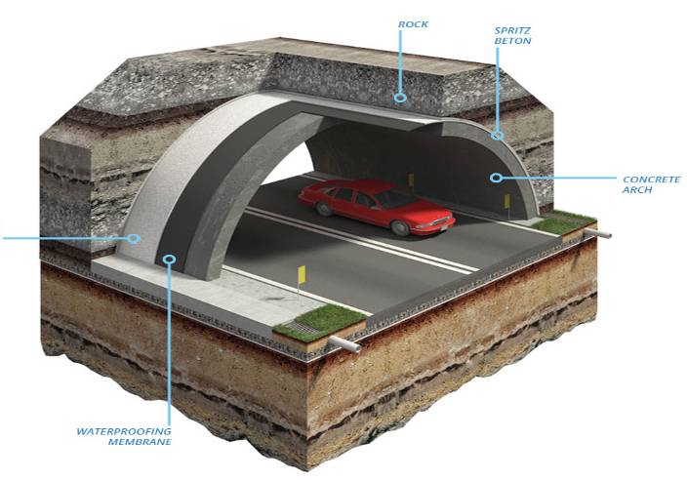
Waterproofing of Tunnels
Geo Textile

Slide 8
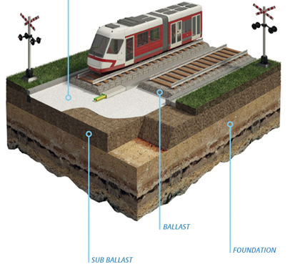
Railways
Geo Textile

Slide 9
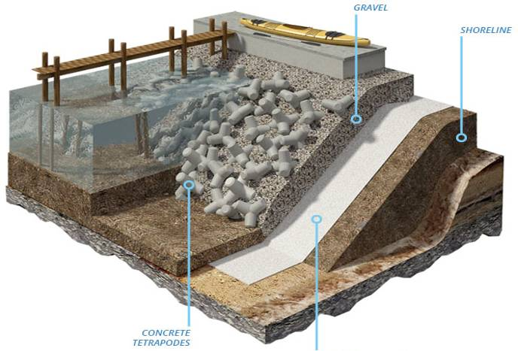
Maritime & River Works
Geo Textile

Slide 10
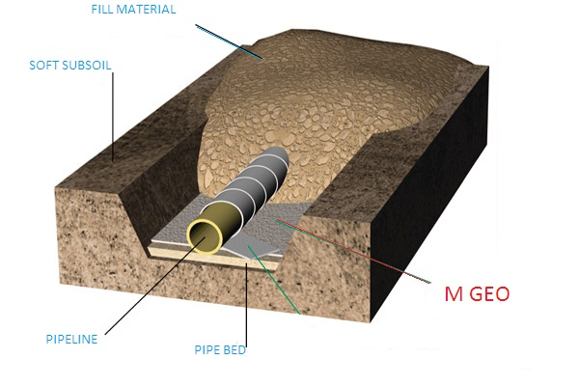
Pipeline

Slide 11
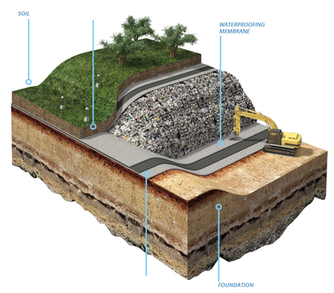
Landfills
Geo Textile

Slide 12
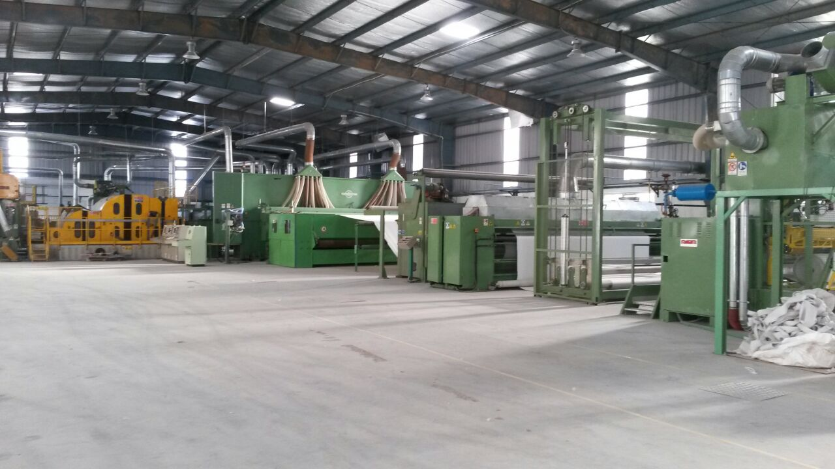
MOST ADVANCED EUROPEAN LINE IN INDIA
MANAS GEO TECH INDIA PVT LTD

Slide 13
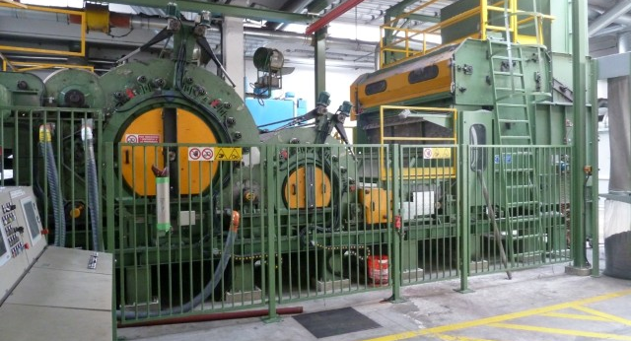
HIGH SPEED CARDING MACHING

Slide 14
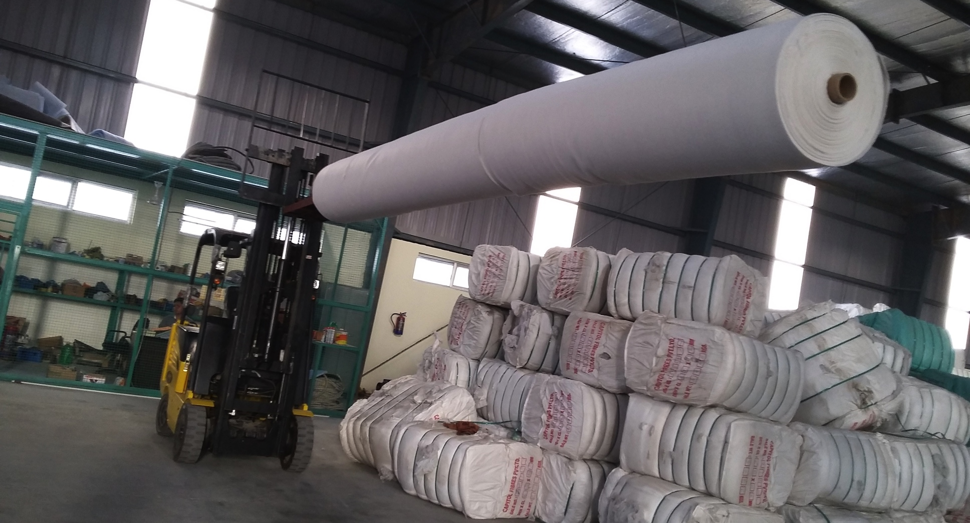
ROLLS UPTO 5.5 METERS

Slide 15
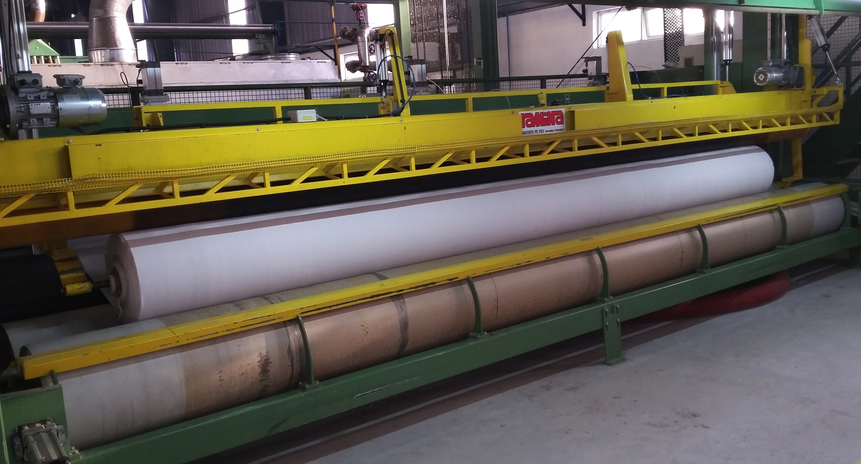
RAMINA WINDER FOR PERFECT ROLL FORMATION

Slide 16
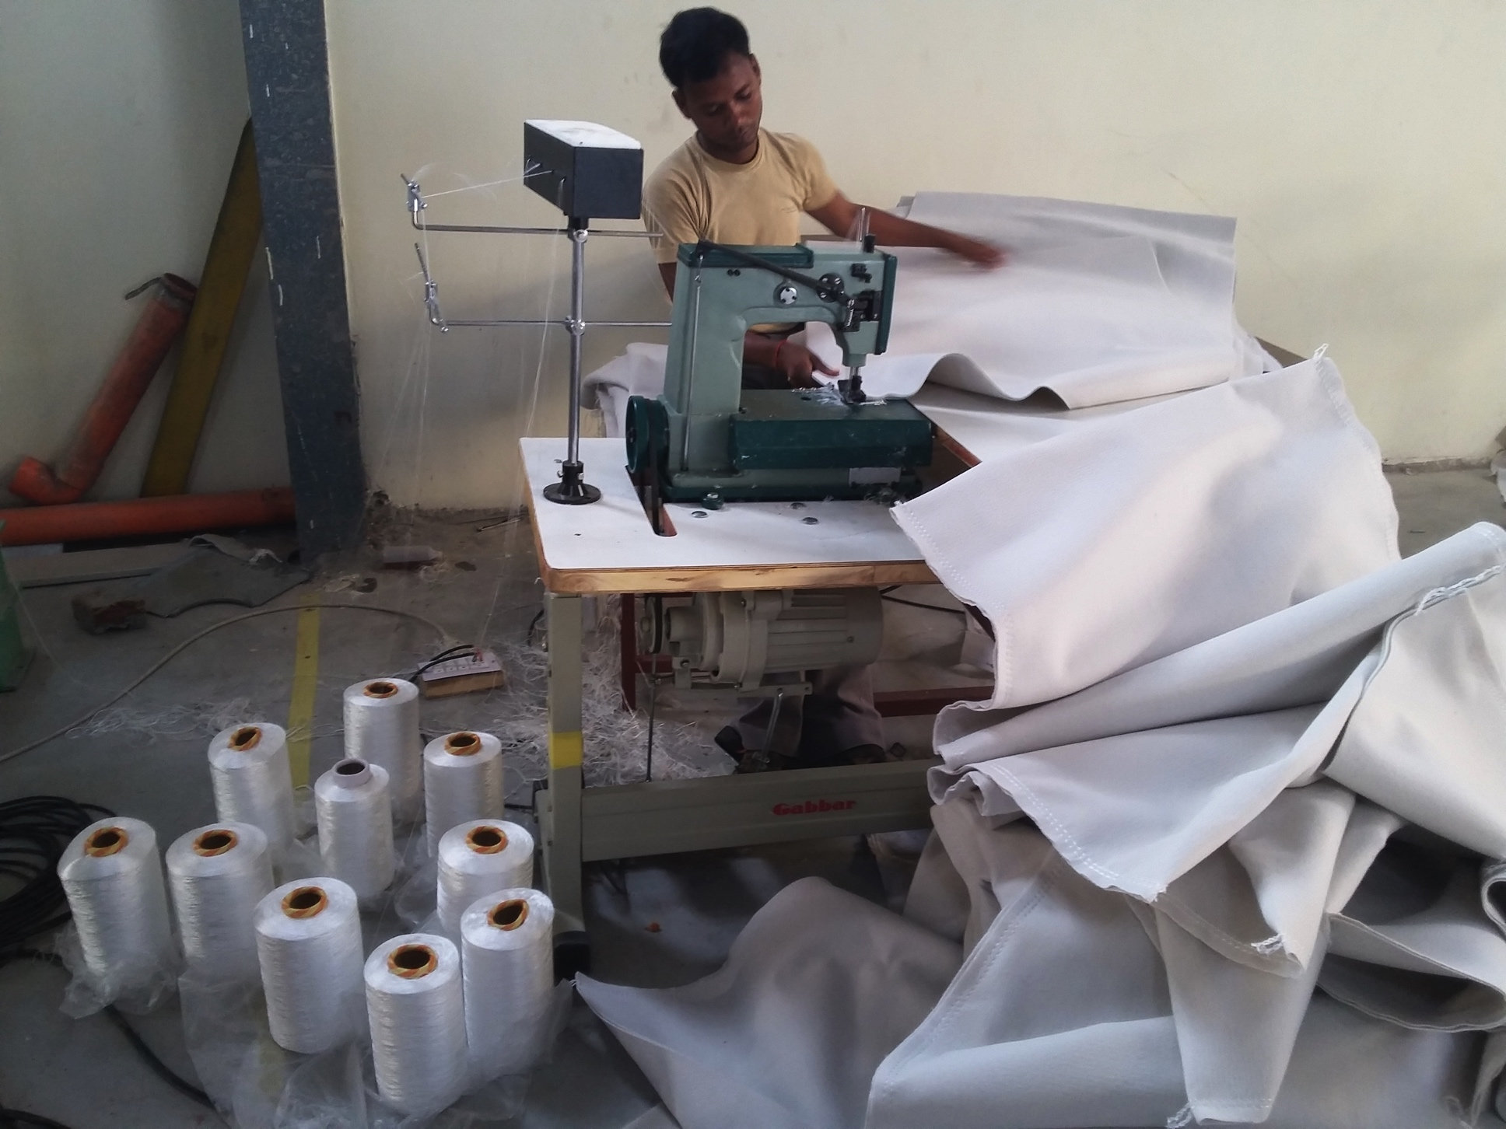
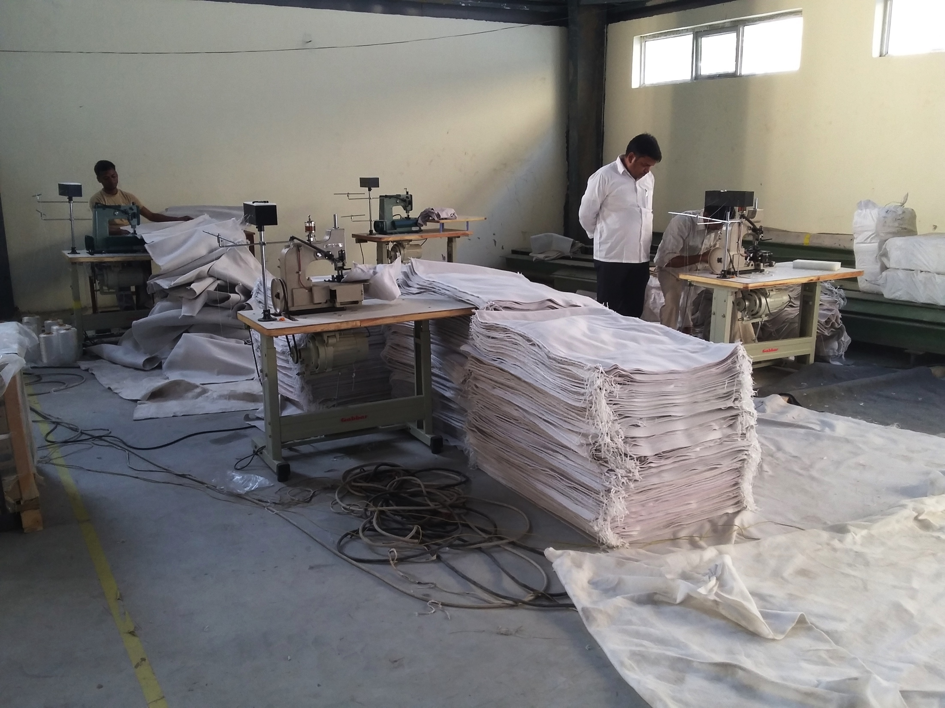
WORLD CLASS STICTHING FACILITY

Slide 17
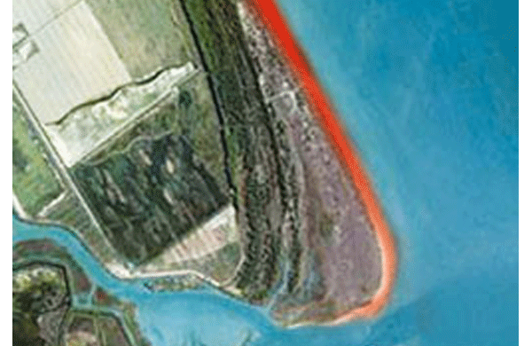
ADVANTAGES OF GEO BAGS
• Affordable price- As compared to conventional erosion protection work using C.C. Block, gravel, hard rock etc sand filled geo bags technology involves less cost.
• World wide it has been seen that erosion protection work using Geo bags requires less installation and maintenance cost.
• The constructing materials like sand of geo bag are locally available and cost-effective compared to importing boulders from other countries.

Slide 18
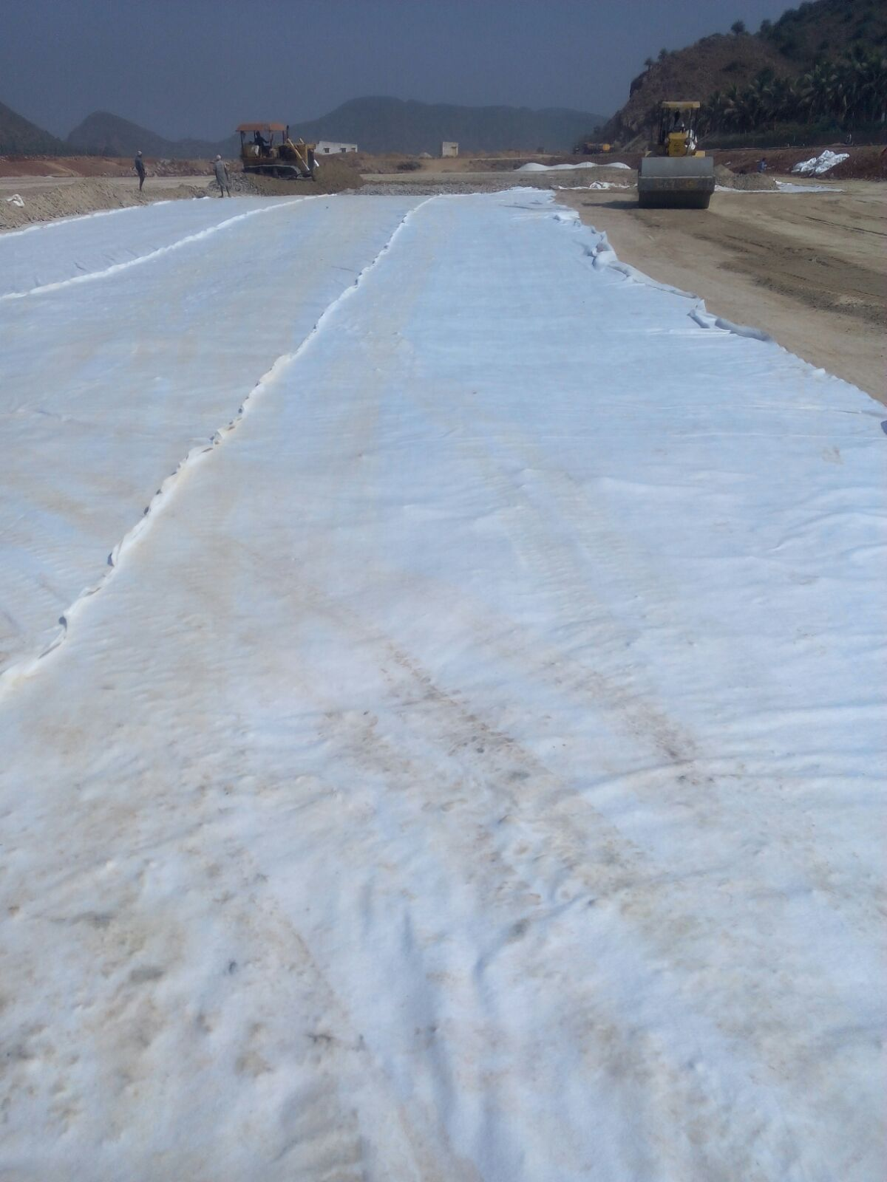
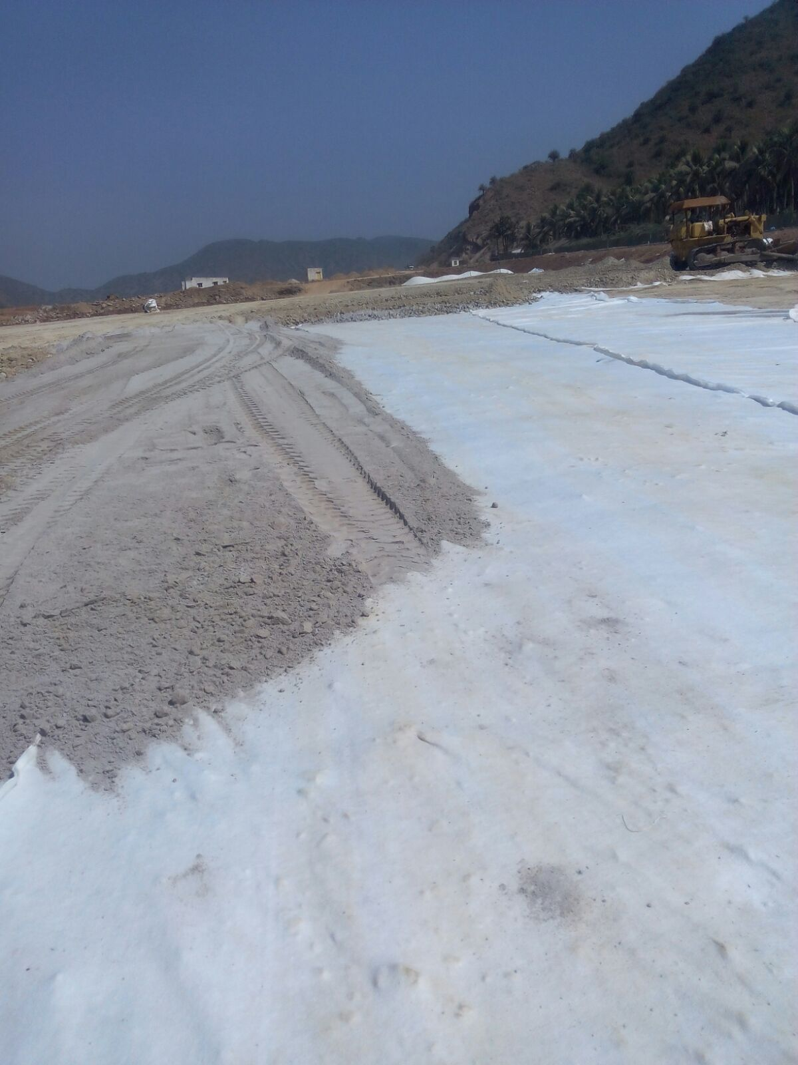
MAJOR PROJECTS
Supplied over 2 Lakh Square Meter Polypropylene Non Woven Geo Textile Meter to DRDO Naval Base Visakhapatnam Project .

Slide 19
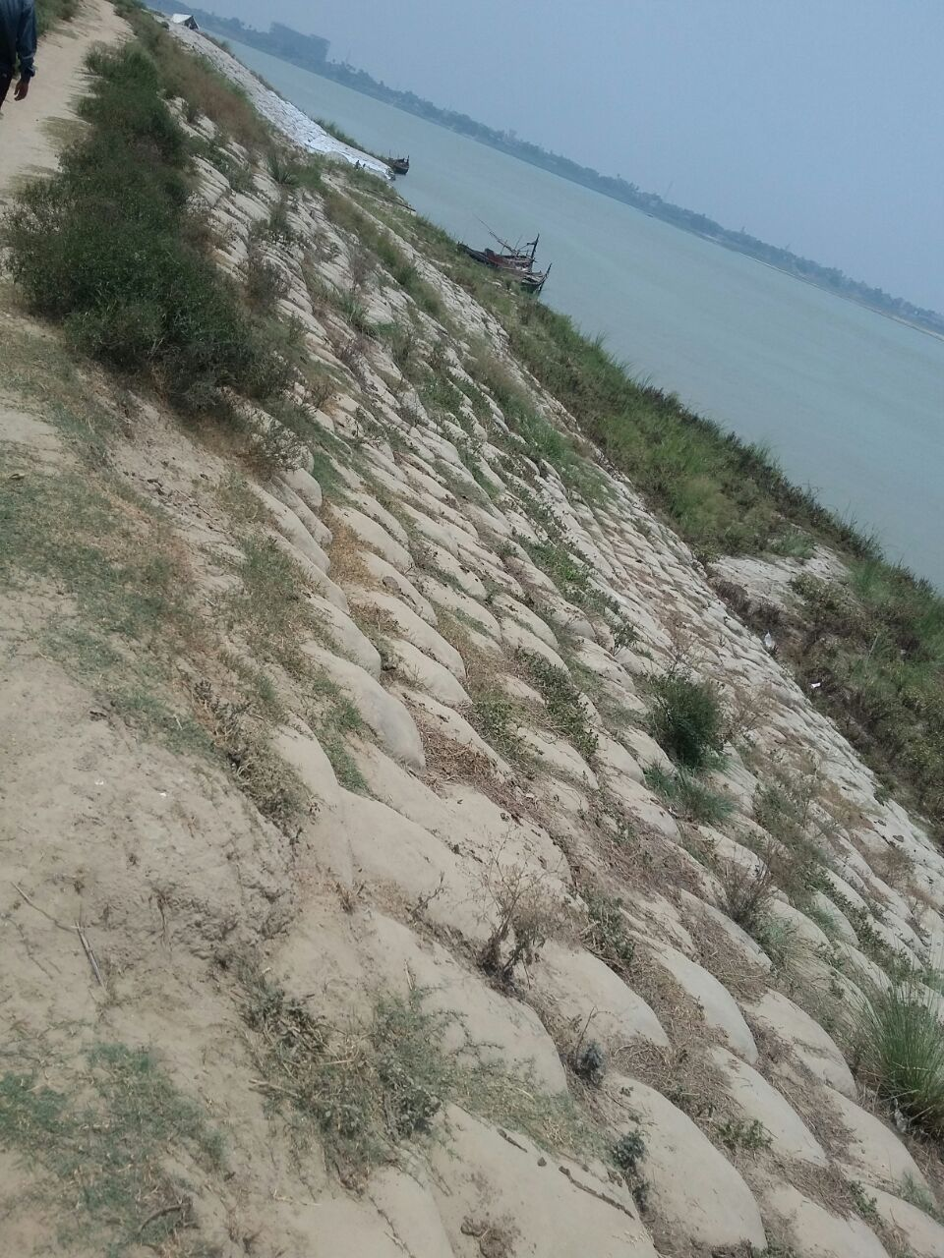
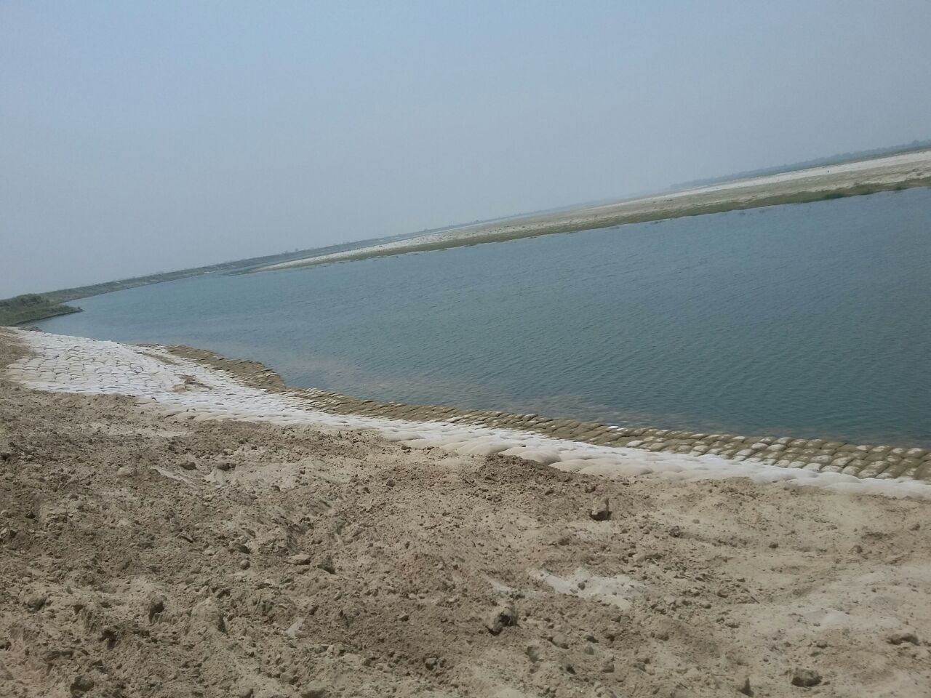
GEO BAG

Slide 20
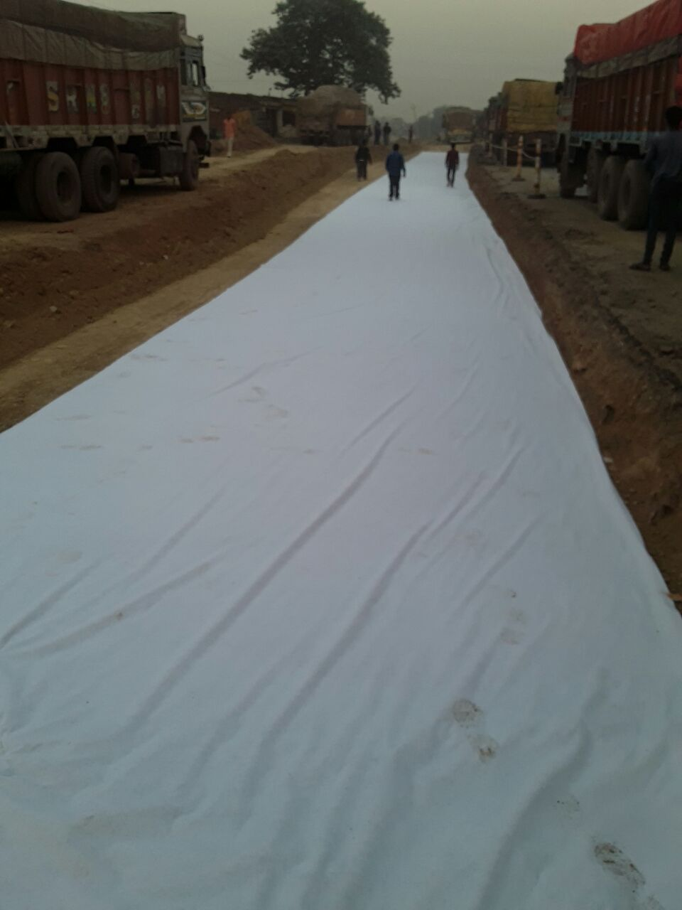
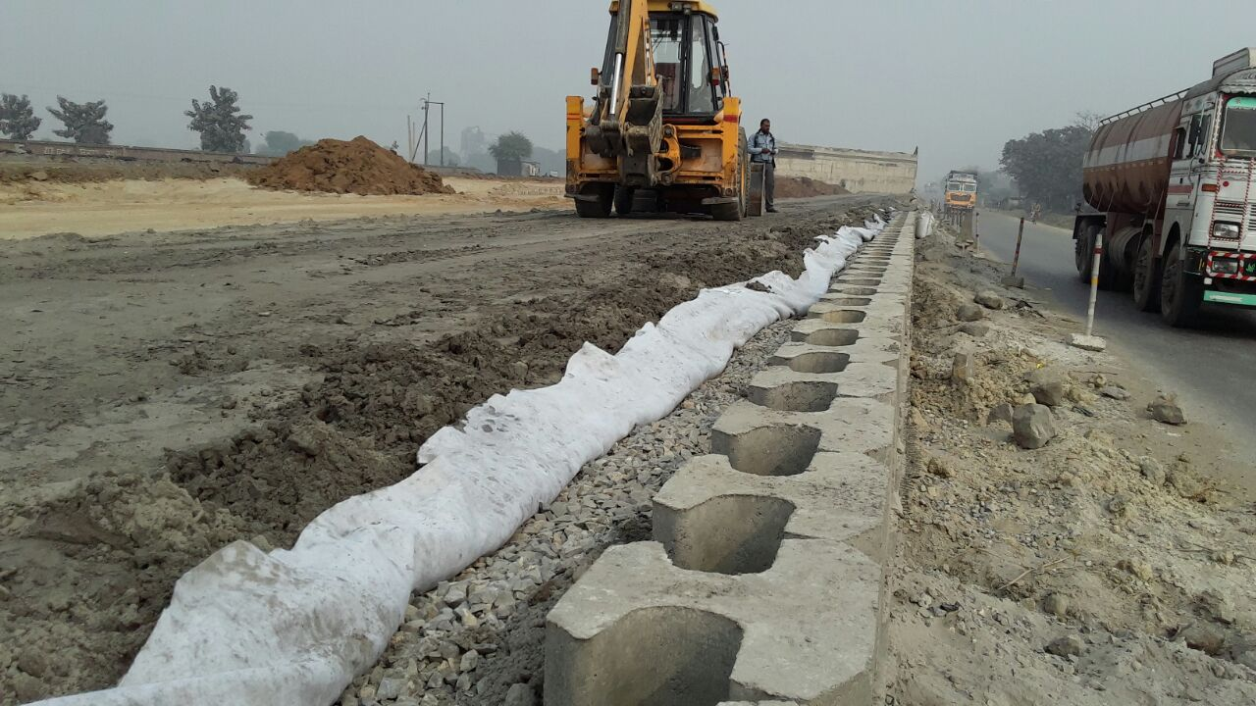
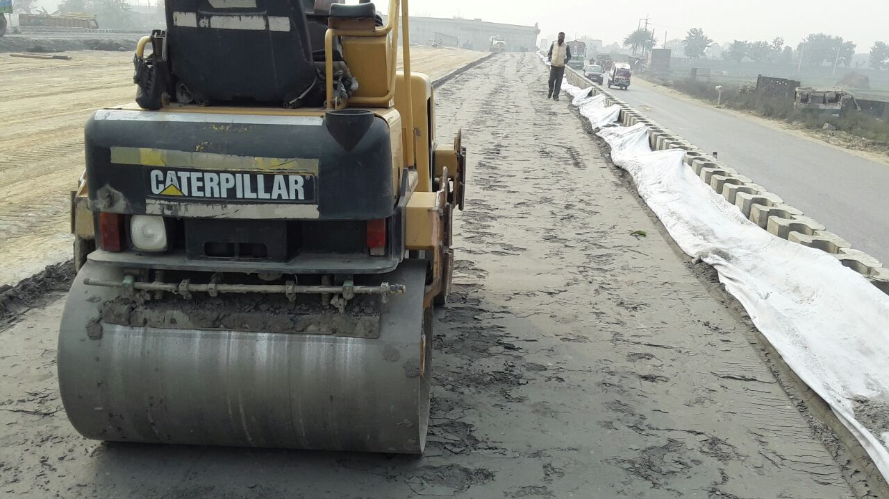
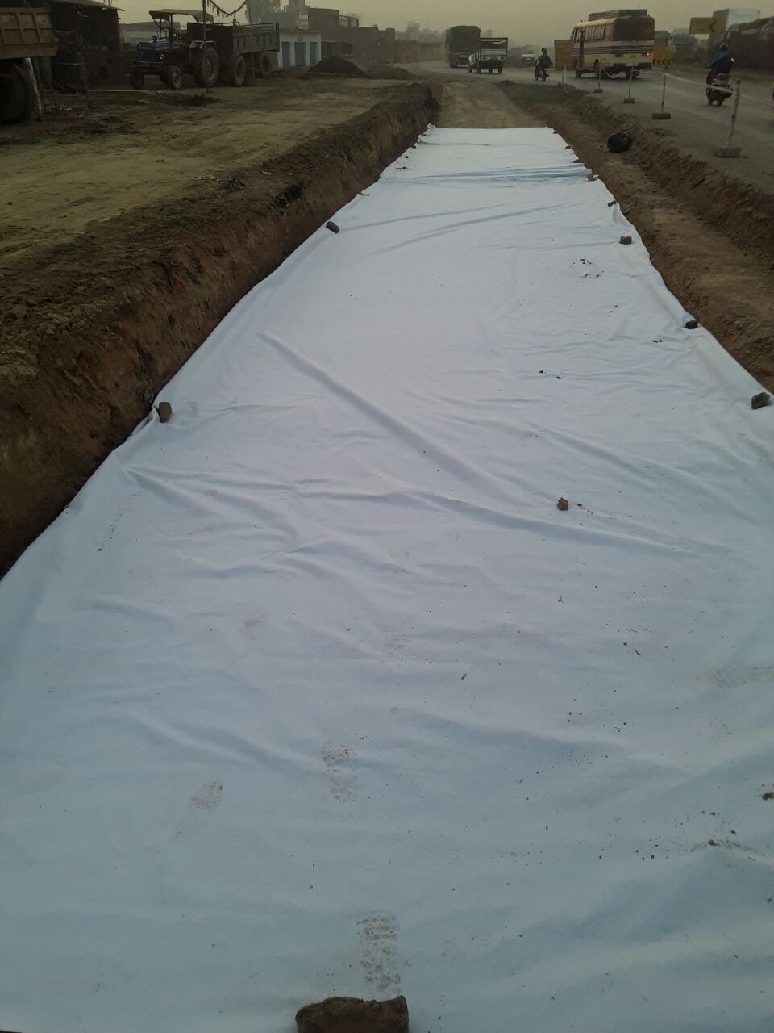
Soma Isolux NH-2 Road Projects
Manas Non Woven Geo Textile was used as Paving Fabric at the Aurangabad Varanasi NH-2 Highway Project. Consultant – EGIS

Slide 21
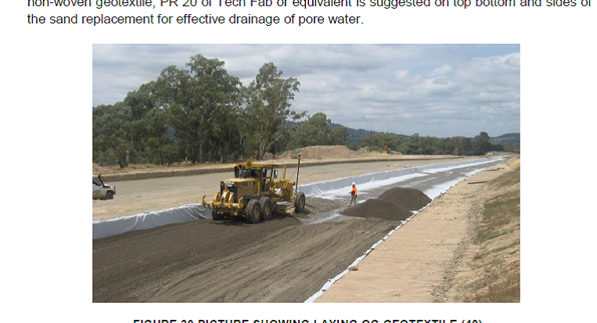
Hindustan Construction Company – URS Scott Wilson
NH-34 West Benga;

Slide 22
Supplied over 5 Lakh Geo Bags to Flood affected areas in Assam in the year 2015

Slide 23
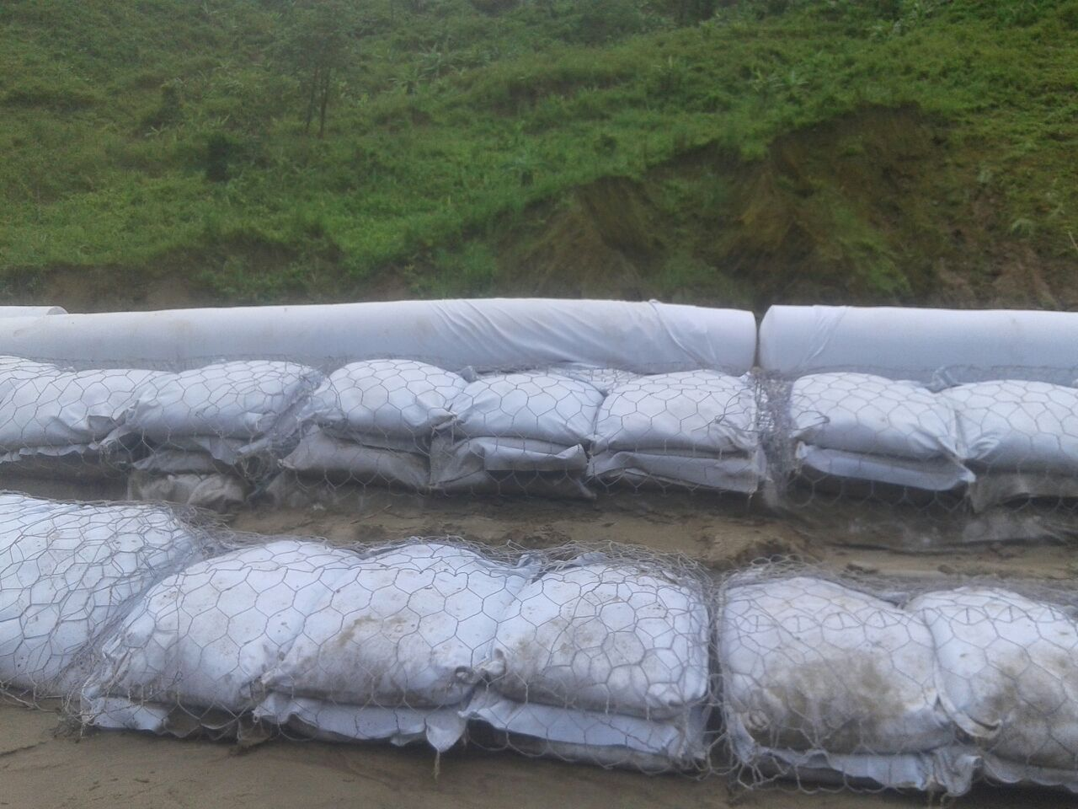
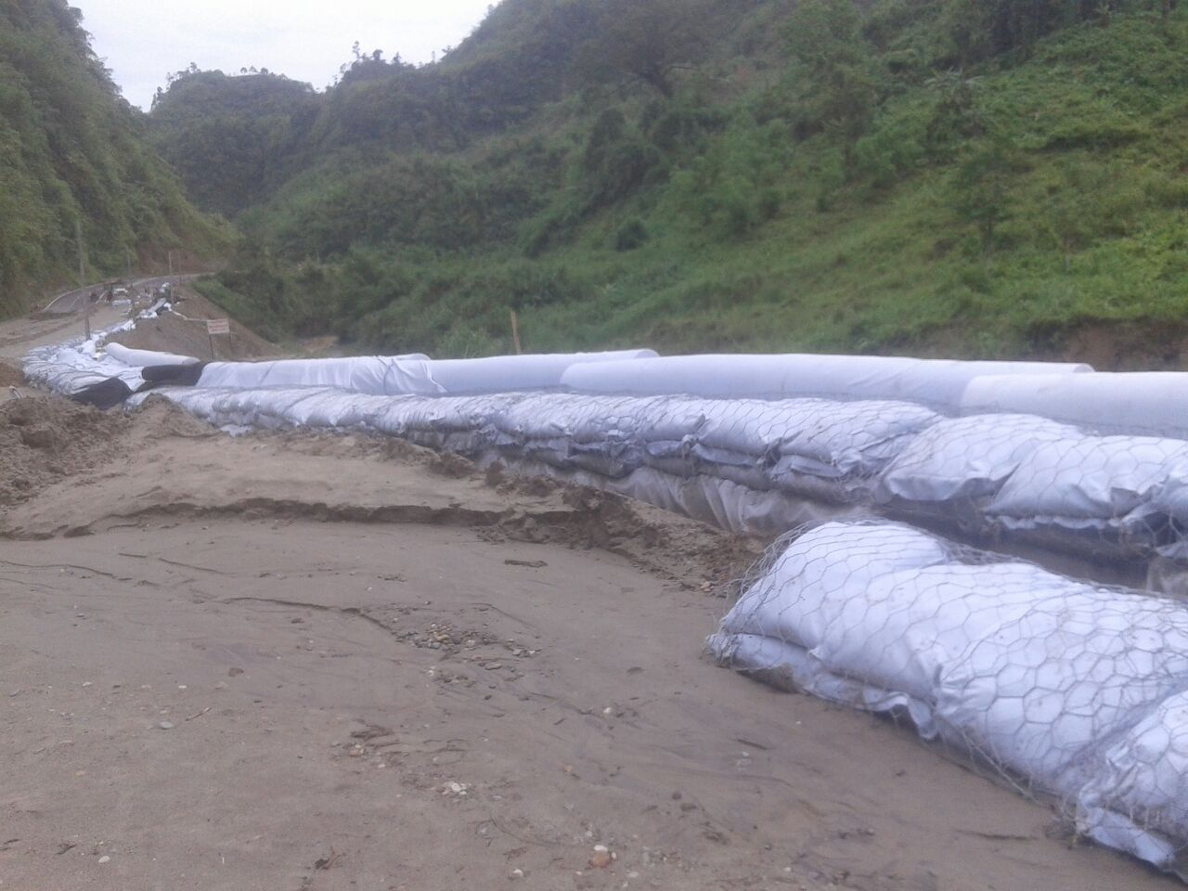
T.K Engineering Arunachal Project

Slide 24
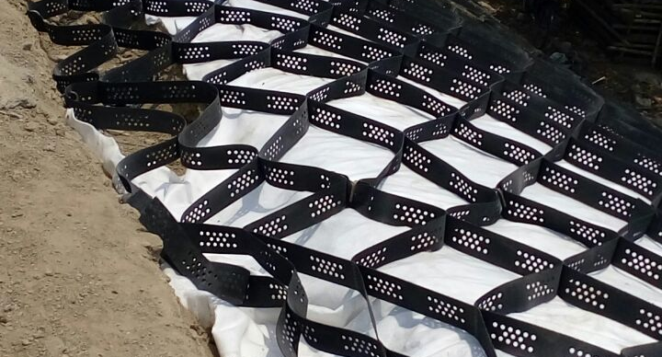
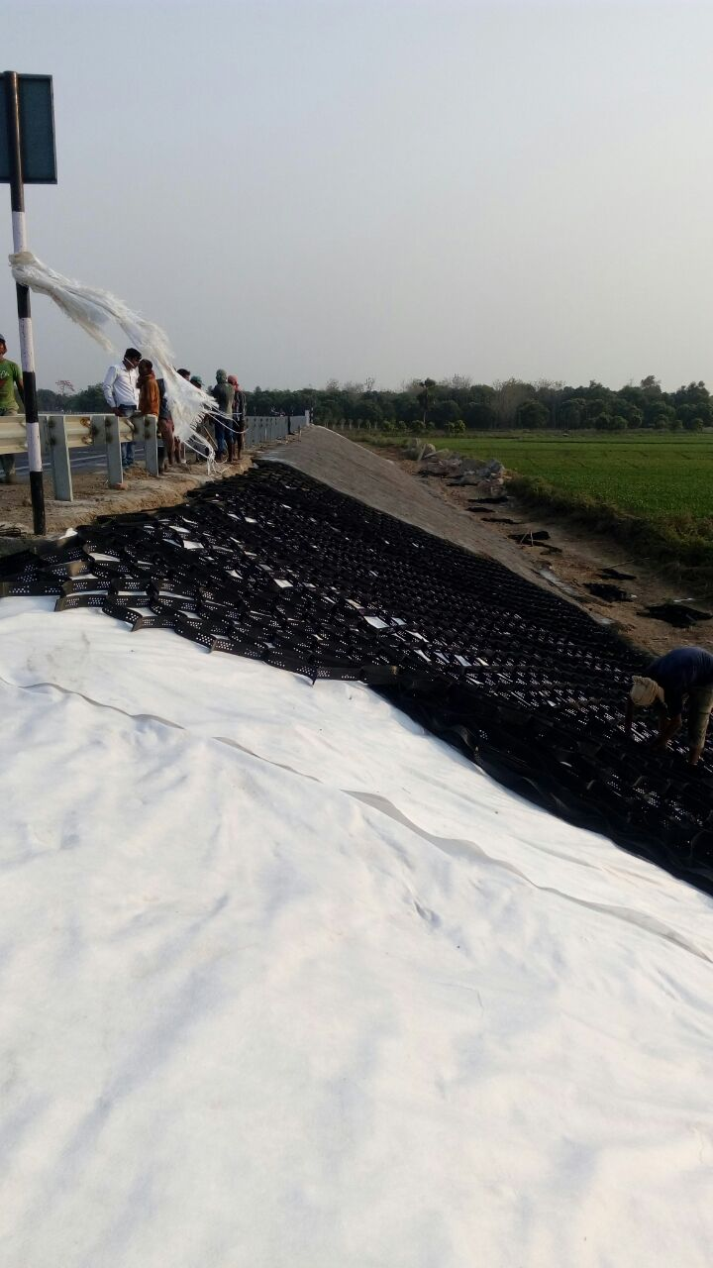
Geo-Textile Replacing Filter Under Stone Pitching
Non Woven Geo Textile As per MORTHH Guideline can be used to replace the 150 MM Gravel Filter Under Stone Pitching , This Provides a cost effective solution & Saves cost where gravel is expensive

Slide 25
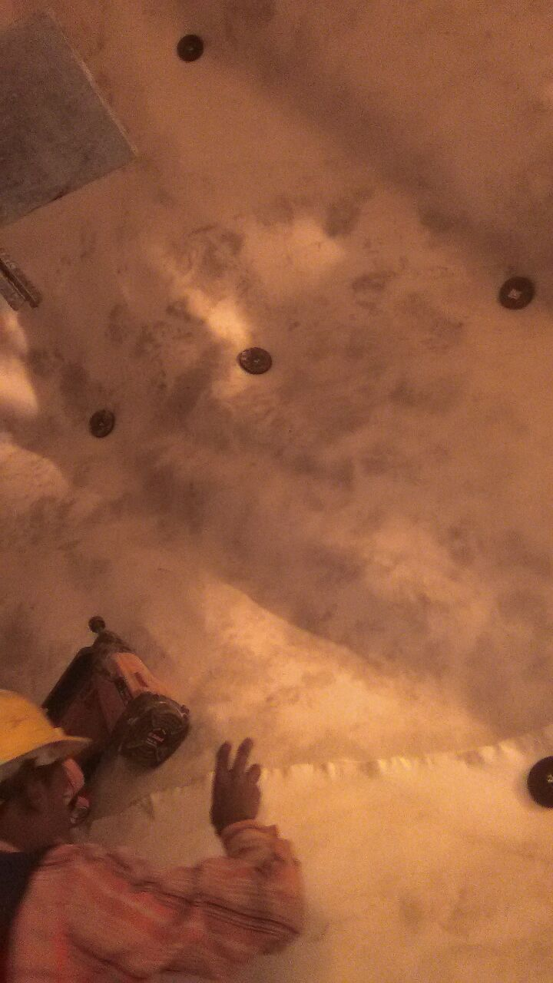
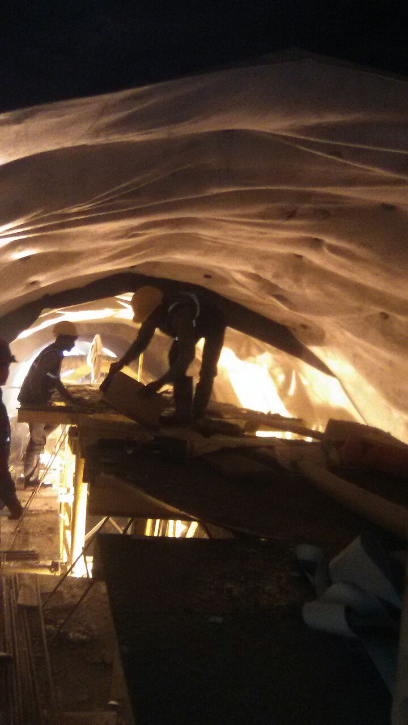
T-74 R IRCON TUNNEL J&K

Slide 26
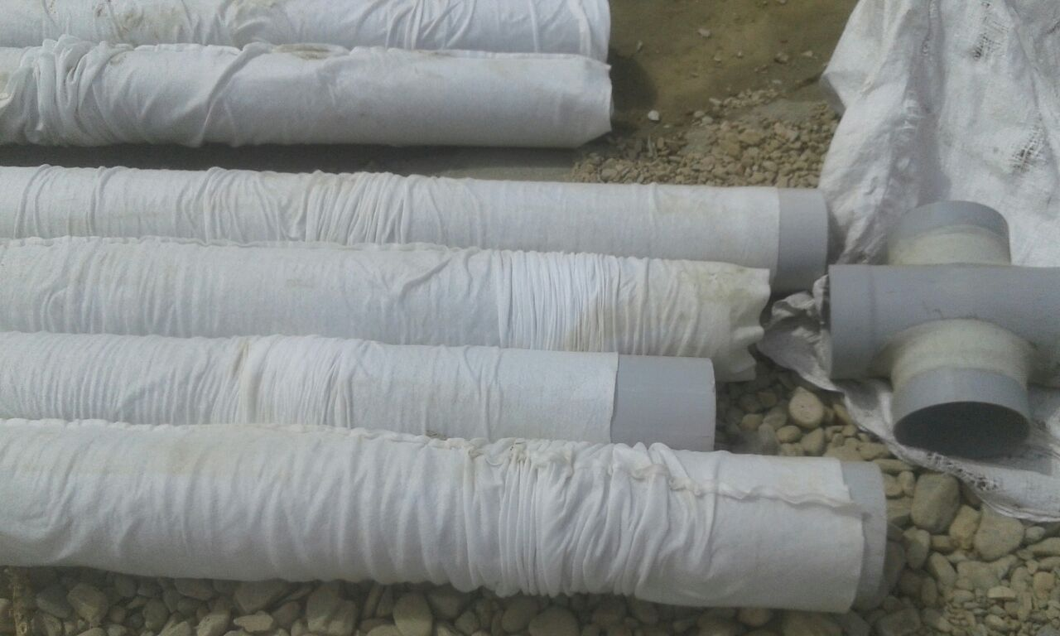
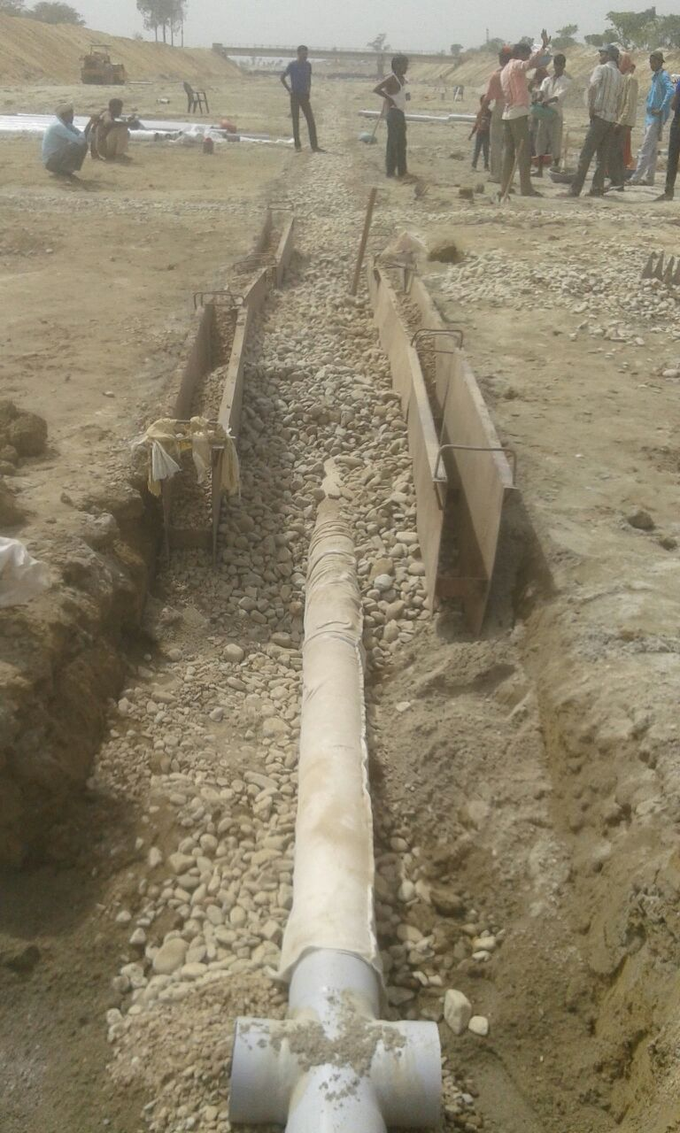
Successfully supplied for Wrapping of Non Woven Geo Textile over Perforated Pipe as a Filter layer in Aligarh , Lower Ganga Canal Project

Slide 27
Other Major Projects
High Grade Non Woven Geo Textile to Tata Aldesa for Dedicated Freight Corridor in Tundla .
Supplying Non Woven Geo Textile for road construction AS-23 & AS-24 in Assam to NKC Projects & Hindustan Construction Company
Supplying 600 GSM Geo Textile for Tunnel Lining in NH 1 A NHAI project in Banihal to Tristar JV Wens & Navayuga Engineering

Slide 28
WHY MANAS GEO TECH?
Quality certifications –ISO 9001-2008, ISO 14001-2004, OHSAS 18001-2007, and CE Marking
Have supplied more than 5 lakh bags to flood affected areas of Bihar and are working with the WRD of Assam
Have supplied our geo textile fabric to major construction companies of India including Hindustan Construction Company, HES Infra, Patel Engineering.
Manas Geo Textile geo textile fabric is being used in the largest Naval Base in Rambilli, Visakhapatnam, India
Our Polypropylene fabric is being used by NHAI in constructing making Highways
Production capacity of 250 tones per month

